Slide 1

Modern C++元编程应用
祁 宇
qicosmos@163.com
purecpp.org

Slide 2
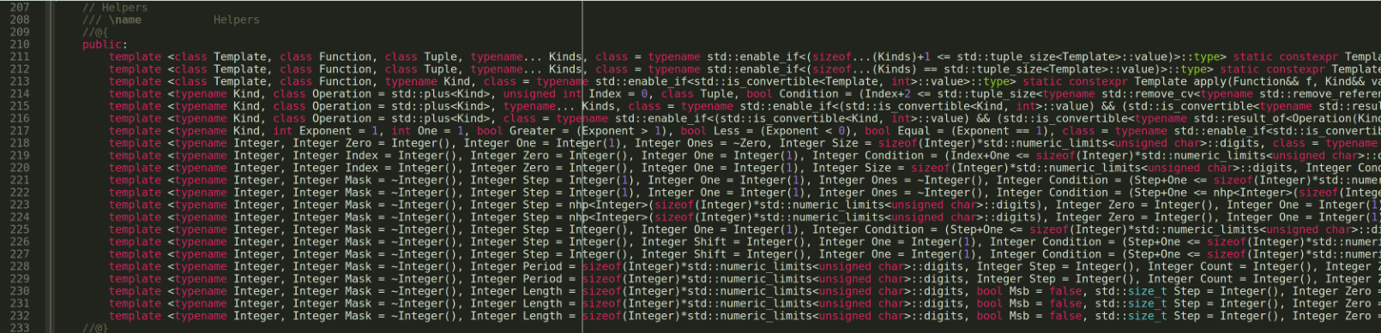
模版元
Notes:
From:https://github.com/CppCon/CppCon2018/blob/master/Presentations/from_metaprogramming_tricks_to_elegance/from_metaprogramming_tricks_to_elegance__vincent_reverdy__cppcon_2018.pdf

Slide 3
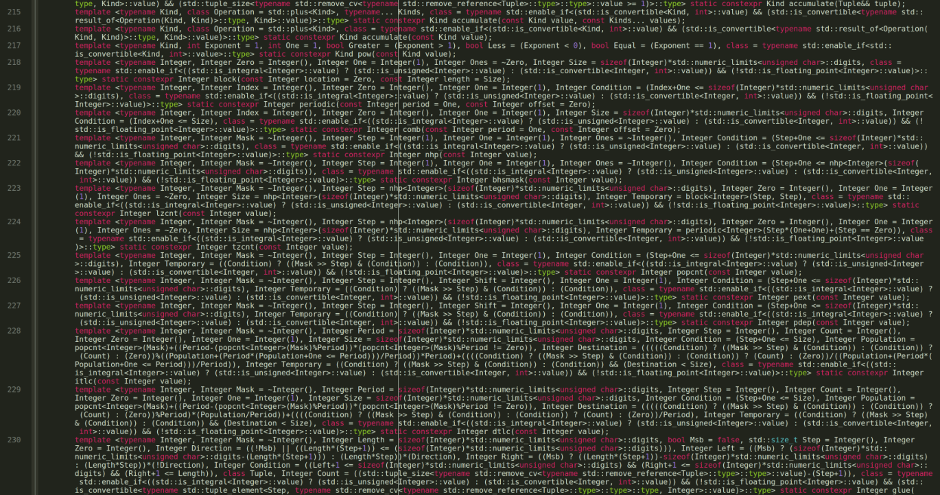

Slide 4
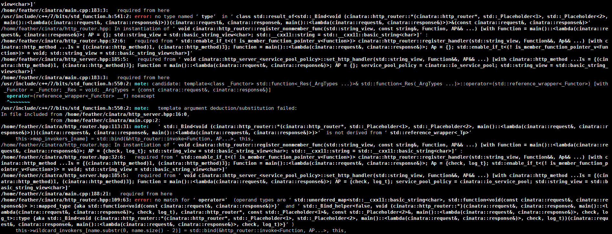
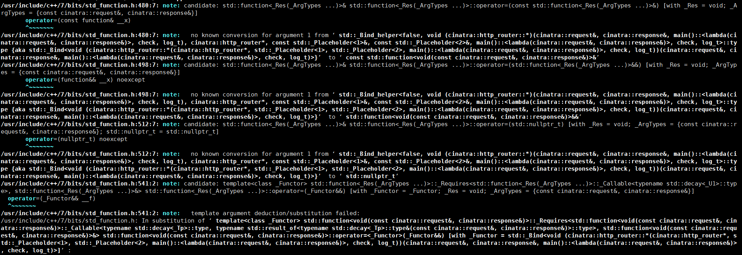

Slide 5

!! 模版元 代码墙!!
在中国C++大会上??

Slide 6
元编程的缺点
代码晦涩
比较难写
编译时间长
糟糕的错误提示

Slide 7
元编程的优点
zero-overhead 编译期计算
简洁而优雅地解决问题
终极抽象
Dream code!

Slide 8


Slide 9
Meta Programming编程思想
In C++03
元函数
SFINAE
模版递归
递归继承
Tag Dispatch
模版特化/偏特化

Slide 10
Meta Programming编程思想
In C++98
template<class T>
struct add_pointer { typedef T* type; };
typedef typename add_pointer<int>::type int_pointer;
元函数：编译期函数调用的类或模版类– add_pointer
调用元函数：访问元函数的内部类型::type
Type T作为元函数的value，类型是元编程中的一等公民

Slide 11
Meta Programming编程思想
In C++98
template<bool B, class T = void>
struct enable_if {};
template<class T>
struct enable_if<true, T> { typedef T type; };
template <class T>
typename enable_if<sizeof(T)==4, void>::type
foo(T t) {}
foo(1); //ok
foo('a'); //compile error
SFINAE：替换失败不是一个错误，基于模版实例化的tag dispatch

Slide 12
Meta Programming编程思想
In C++98
template <int n> struct fact98 {
static const int value = n * fact98<n - 1>::value;
};
template <> struct fact98<0> {
static const int value = 1;
};
std::cout << fact98<5>::value << std::endl;
模版递归

Slide 13
Meta Programming编程思想
In C++98
模版元编程集大成者：boost.mpl, boost.fusion
boost.mpl：编译期类型容器和算法
boost.fusion：通过异构的编译期容器融合编译期和运行期计算
struct print{
template <typename T>
void operator()(T const& x) const{
std::cout << typeid(x).name() << std::endl;
}
};
template <typename Sequence>
void print_names(Sequence const& seq){
for_each(filter_if<boost::is_class<_> >(seq), print());
}
boost::fusion::vector<int, char, std::string> stuff(2018, 'i', "purecpp");
print_names(stuff);

Slide 14
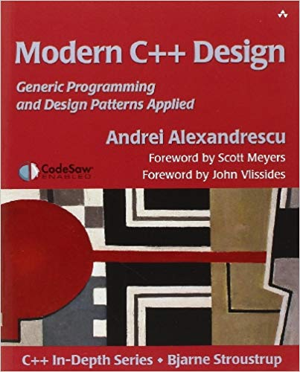

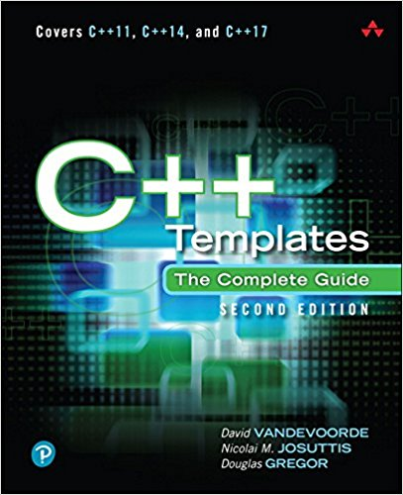
Meta Programming编程思想
In C++03
Andrei Alexandrescu

Slide 15
Meta Programming编程思想
In C++98
In C++11
template<class T>
struct add_pointer { typedef T* type; };
typedef typename add_pointer<int>::type int_pointer;
template<class T> using add_pointer = T*;
using int_pointer = add_pointer<int>;
C++11 template aliases（模版别名）
元函数由类和类模版变为模版别名

Slide 16
Meta Programming编程思想
In C++11
template<typename... Values> struct meta_list {};
using list_of_ints = meta_list<char, short, int, long>;
template<class List> struct list_size;
template<template<class...> class List, class... Elements>
struct list_size<List<Elements...>>
: std::integral_constant<std::size_t, sizeof...(Elements)> {};
constexpr auto size = list_size<std::tuple<int, float, void>>::value;
constexpr auto size1 = list_size<list_of_ints>::value;
constexpr auto size2 = list_size<boost::variant<int, float>>::value;
C++11 Variadic Templates
Variadic templates作为类型容器
通过variadic templates pack访问模版参数，不通过模版递归

Slide 17
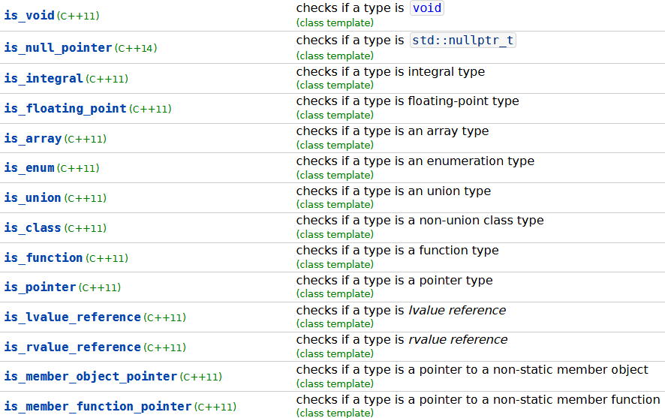
Meta Programming编程思想
C++11 type_traits提供了大量的元函数，让模版元编程变得更简单

Slide 18
Meta Programming编程思想
In C++98
In C++11
template <int n> struct fact98 {
static const int value = n * fact98<n - 1>::value;
};
template <> struct fact98<0> {
static const int value = 1;
};
std::cout << fact98<5>::value << std::endl;
constexpr int fact11(int n) {
return n <= 1 ? 1 : (n * fact11(n - 1));
}

Slide 19
Meta Programming编程思想
In C++11
In C++14
constexpr int fact11(int n) {
return n <= 1 ? 1 : (n * fact11(n - 1));
}
constexpr int fact14(int n) {
int s = 1;
for (int i = 1; i <= n; i++) { s = s * i; }
return s;
}

Slide 20

Meta Programming编程思想
In C++14
Everything changed in meta programming
新特性产生新的编程思想！
constexpr, generic lambda, variable template
Boost.hana
Louis Dionne

Slide 21
Meta Programming编程思想
Boost.hana
template <typename T>
struct type_wrapper {
using type = T;
};
template <typename T>
type_wrapper<T> type{};
//type to value
auto the_int_type = type<int>;
//value to type
using the_real_int_type = decltype(the_int_type)::type;

Slide 22
Meta Programming编程思想
Boost.hana
template <typename T>
type_wrapper<T> type{};
constexpr auto add_pointer = [](auto t) {
using T = typename decltype(t)::type;
return type<std::add_pointer_t<T>>; //type to value
};
constexpr auto intptr = add_pointer(type<int>);
static_assert(std::is_same_v<decltype(intptr)::type, int*>); //value to type
元函数的定义不再是类了，而是lambda!
generic lambda, variable template, constexpr
functional programming

Slide 23
Meta Programming编程思想
Boost.hana
auto animal_types = hana::make_tuple(hana::type_c<Fish*>, hana::type_c<Cat&>, hana::type_c<Dog*>);
auto animal_ptrs = hana::filter(animal_types, [](auto a) {
return hana::traits::is_pointer(a);
});
static_assert(animal_ptrs == hana::make_tuple(hana::type_c<Fish*>, hana::type_c<Dog*>), "");
auto animal_types = hana::make_tuple(hana::type_c<Fish*>, hana::type_c<Cat&>, hana::type_c<Dog*>);
auto animal_ptrs = hana::filter(animal_types, [](auto a) {
return hana::traits::is_pointer(a);
});
static_assert(animal_ptrs == hana::make_tuple(hana::type_c<Fish*>, hana::type_c<Dog*>), "");
通过类型容器融合编译期和运行期计算，替代boost.mpl和boost.fusion!

Slide 24
Meta Programming编程思想
Boost.hana
元函数不再是类或类模版，而是lambda
不再基于类型，而是基于值
没有SFINAE，没有模版递归
函数式编程
代码更容易理解
元编程变得更简单
融合编译期与运行期

Slide 25
Meta Programming编程思想
In C++14
In C++17
template<std::size_t I>
auto& get(person& p);
template<>
auto& get<0>(person& p) {
return p.id;
}
template<>
auto& get<1>(person& p) {
return p.name;
}
template<>
auto& get<2>(person& p) {
return p.age;
}
template<std::size_t I>
auto& get(person& p) {
if constexpr (I == 0) {
return p.id;
}
else if constexpr (I == 1) {
return p.name;
}
else if constexpr (I == 2) {
return p.age;
}
}

Slide 26
Meta Programming编程思想
In C++14
In C++17
template <typename T>
std::enable_if_t<std::is_same_v<T, std::string>, std::string> to_string(T t){
return t;
}
template <typename T>
std::enable_if_t<!std::is_same_v<T, std::string>, std::string> to_string(T t){
return std::to_string(t);
}
template <typename T>
std::string to_string(T t){
if constexpr(std::is_same_v<T, std::string>)
return t;
else
return std::to_string(t);
}
No SFINAE

Slide 27

C++新标准新特性产生新的idea，让元编程变得更简单更强大
C++03: boost.mpl, boost.fusion
C++11: boost.mp11, meta, brigand
C++14: boost.hana
variable templates
generic lambda
constexpr
constexpr
template aliases variadic templates
SFINAE
recursive
tag dispatch
specialize
C++14
C++11
C++98
Newer is Better！

Slide 28


Slide 29

静态检查

Slide 30
静态检查
static_assert(sizeof(void *) == 8, "expected 64-bit platform");
template<typename T, int Row, int Column>
struct Matrix {
static_assert(Row >= 0, "Row number must be positive.");
static_assert(Row >= 0, "Column number must be positive.");
static_assert(Row + Column > 0, "Row and Column must be greater than 0.");
};
Notes:
Put comments in code

Slide 31
静态检查
struct A {
void foo(){}
int member;
};
template<typename Function>
std::enable_if_t<!std::is_member_function_pointer_v<Function>> foo(Function&& f) {
}
foo([] {}); //ok
foo(&A::foo); //compile error: no matching function for call to 'foo(void (A::*)())'
安全，尽可能早地发现bug，让编译器而不是人帮助发现bug
Notes:
Put comments in code

Slide 32
静态检查
编译期探测

Slide 33
探测
template< class, class = void >
struct has_foo : std::false_type {};
template< class T >
struct has_foo< T, std::void_t<decltype(std::declval<T>().foo())> > :
std::true_type {};
template< class, class = void >
struct has_member : std::false_type {};
template< class T >
struct has_member< T, std::void_t<decltype(std::declval<T>().member)> > :
std::true_type {};
struct A {
void foo(){}
int member;
};
static_assert(has_foo< A >::value);
static_assert(has_member< A >::value);
decltype, void_t, SFINAE In C++17
Notes:
Put comments in code

Slide 34
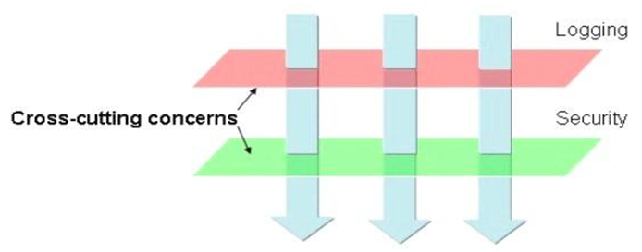
探测
AOP(Aspect Oriented Programming)
Core business
Non-core business aspects

Slide 35
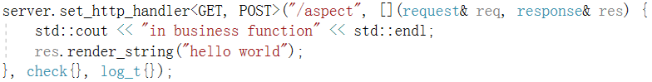
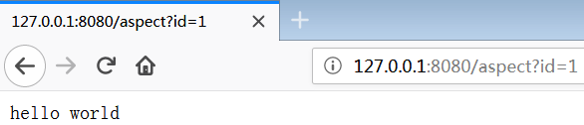
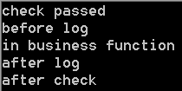
Before aspects
After aspects
request
Core business function
response
check
aspect
log
aspect
log
aspect
check
aspect

Slide 36
探测
AOP
constexpr bool has_befor_mtd = has_before<decltype(item), request&, response&>::value;
if constexpr (has_befor_mtd)
r = item.before(req, res);
constexpr bool has_after_mtd = has_after<decltype(item), request&, response&>::value;
if constexpr (has_after_mtd)
r = item.after(req, res);

Slide 37
探测
AOP(Aspect Oriented Programming)
#define HAS_MEMBER(member)\
template<typename T, typename... Args>\
struct has_##member\
{\
private:\
template<typename U> static auto Check(int) -> decltype(std::declval<U>().member(std::declval<Args>()...), std::true_type()); \
template<typename U> static std::false_type Check(...);\
public:\
enum{value = std::is_same<decltype(Check<T>(0)), std::true_type>::value};\
};
HAS_MEMBER(before)
HAS_MEMBER(after)
AOP in feather : https://github.com/qicosmos/feather

Slide 38
静态检查
编译期探测
编译期计算

Slide 39
编译期计算
类型计算
类型推导
类型萃取
类型转换
数值计算
表达式树，Xtensor, Eigen, Mshadow

Slide 40
类型萃取
template<typename Ret, typename... Args>
struct function_traits_impl<Ret(Args...)>{
public:
enum { arity = sizeof...(Args) };
typedef Ret function_type(Args...);
typedef Ret result_type;
using stl_function_type = std::function<function_type>;
typedef Ret(*pointer)(Args...);
template<size_t I>
struct args{
static_assert(I < arity, "index is out of range, index must less than sizeof Args");
using type = typename std::tuple_element<I, std::tuple<Args...>>::type;
};
typedef std::tuple<std::remove_cv_t<std::remove_reference_t<Args>>...> tuple_type;
using args_type_t = std::tuple<Args...>;
};
function_traits in cinatra: https://github.com/qicosmos/cinatra

Slide 41
类型萃取
rpc路由
struct rpc_service {
int add(int a, int b) { return a + b; }
std::string translate(const std::string& orignal) {
std::string temp = orignal;
for (auto& c : temp) c = toupper(c);
return temp;
}
};
rpc_server server;
rpc_service rpc_srv;
server.register_handler("add", &rpc_service::add, &rpc_srv);
server.register_handler("translate", &rpc_service::translate, &rpc_srv);
Modern C++ rpc库rest_rpc: https://github.com/qicosmos/rest_rpc

Slide 42
类型萃取
http路由
Modern C++ http库cinatra: https://github.com/qicosmos/cinatra

Slide 43
类型萃取
路由
template<typename Function>
void register_nonmember_func(std::string const& name, const Function& f) {
this->map_invokers_[name] = { std::bind(&invoker<Function>::apply, f, std::placeholders::_1, std::placeholders::_2, std::placeholders::_3) };
}
template<typename Function>
struct invoker {
static void apply(const Function& func, const char* data, size_t size,
std::string& result) {
using args_tuple = typename function_traits<Function>::args_tuple;
msgpack_codec codec;
auto tp = codec.unpack<args_tuple>(data, size);
call(func, result, tp);
}
};

Slide 44
类型萃取
路由
template<typename F, size_t... I, typename... Args>
typename std::result_of<F(Args...)>::type call_helper(
const F& f, const std::index_sequence<I...>&, const std::tuple<Args...>& tup) {
return f(std::get<I>(tup)...);
}
template<typename F, typename... Args>
typename std::enable_if<std::is_void<typename std::result_of<F(Args...)>::type>::value>::type
call(const F& f, std::string& result, std::tuple<Args...>& tp) {
call_helper(f, std::make_index_sequence<sizeof...(Args)>{}, tp);
result = msgpack_codec::pack_args_str(result_code::OK);
}

Slide 45
静态检查
编译期探测
编译期计算
编译期反射

Slide 46
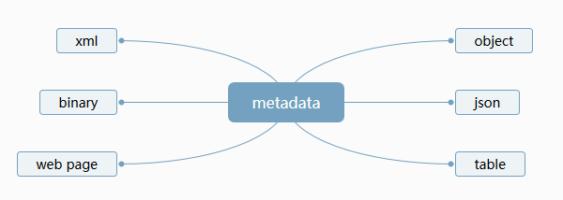
编译期反射
编译期反射
struct person{
std::string name;
int age;
};
REFLECTION(person, name, age)
reflection
reflection

Slide 47
编译期反射
序列化引擎
ORM
协议适配器
person p = {"tom", 20};
iguana::string_stream ss;
to_xml(ss, p);
to_json(ss, p);
to_msgpack(ss, p);
to_protobuf(ss, p);
ormpp::dbng<mysql> mysql;
ormpp:: dbng<sqlite> sqlite;
ormpp:: dbng<postgresql> postgres;
mysql.create_datatable<person>()
sqlite.create_datatable<person>()
postgres.create_datatable<person>()
基于编译期反射的序列化引擎iguana: https://github.com/qicosmos/iguana
基于编译期反射的ORM库ormpp: https://github.com/qicosmos/ormpp

Slide 48
静态检查
编译期探测
编译期计算
编译期反射
融合编译期和运行期

Slide 49
静态检查
编译期探测
编译期计算
编译期反射
融合编译期和运行期
接口泛化与统一

Slide 50
静态检查
编译期探测
编译期计算
编译期反射
融合编译期和运行期
接口泛化与统一
消除重复(宏)

Slide 51
消除重复（宏）
序列化引擎
ORM
协议适配器
person p = {"tom", 20};
iguana::string_stream ss;
to_xml(ss, p);
to_json(ss, p);
to_msgpack(ss, p);
to_protobuf(ss, p);
ormpp::dbng<mysql> mysql;
ormpp:: dbng<sqlite> sqlite;
ormpp:: dbng<postgresql> postgres;
mysql.create_datatable<person>()
sqlite.create_datatable<person>()
postgres.create_datatable<person>()
基于编译期反射的序列化引擎iguana: https://github.com/qicosmos/iguana
基于编译期反射的ORM库ormpp: https://github.com/qicosmos/ormpp

Slide 52
静态检查
编译期探测
编译期计算
编译期反射
融合编译期和运行期
接口泛化与统一
消除重复(宏)
接口易用和灵活

Slide 53

静态检查
编译期探测
编译期计算
编译期反射
融合编译期和运行期
接口泛化与统一
消除重复(宏)
接口易用和灵活
使用元编程

Slide 54

Thank you!
Code: https://github.com/qicosmos
Video: https://www.youtube.com/watch?v=qNAbGpV1ZkU
@hogliux
fabian.renn@gmail.com
Notes:
Be able to open the code quickly, print-out -

Slide 55
Optional run-time lookup
Only add Value pointer the first time get_internal is called
struct ValueWrapper
{
ValueWrapper (const Key& key) { runtime_map[key] = &v; }
Value v;
};
Faster: Only executed the first time get_internal is called!
template <typename>
static Value& get_internal (const Key& key)
{
static ValueWrapper value(key);
return value.v;
}

